Slide 1



Master of Science in Data Science and Networking Intelligence
Promotion 2023/2024
INTERNSHIP REPORT
Theme: Confidence Intervals
Internship conducted by Victor de Carvalho Silva from 01/03/2024 to 30/09/2024 at
Company Supervisor: Antoine de Bossoreille School Supervisor: Marius Preda

Slide 2

COMPANY OVERVIEW

Slide 3

RENAULT GROUP
Founded in 1899 by Louis Renault and his brothers, Marcel and Fernand.
Main Brands: Renault, Dacia, Alpine, and Mobilize.
Renault-Nissan-Mitsubishi Alliance: Formed in 1999, one of the largest automotive alliances in the world.
Operates in over 130 countries with a wide range of vehicles.
Sustainability Goal: "Renaulution" – Strategy for electrification and environmental sustainability.
Company overview

Slide 4

RENAULT GROUP
Founded in 1899 by Louis Renault and his brothers, Marcel and Fernand.
Main Brands: Renault, Dacia, Alpine, and Mobilize.
Renault-Nissan-Mitsubishi Alliance: Formed in 1999, one of the largest automotive alliances in the world.
Operates in over 130 countries with a wide range of vehicles.
Sustainability Goal: "Renaulution" – Strategy for electrification and environmental sustainability.
Ampere Cars, a division of Renault, focuses on 100% electric vehicle development.
Leading innovations in electric platforms, high-density batteries, and fast charging technologies.
Committed to sustainable production practices and enhancing user experiences with connected services.
Company overview

Slide 5
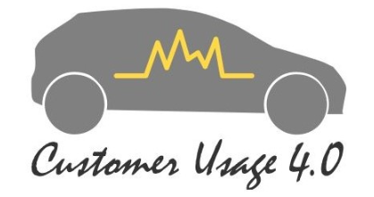
RENAULT GROUP
Founded in 1899 by Louis Renault and his brothers, Marcel and Fernand.
Main Brands: Renault, Dacia, Alpine, and Mobilize.
Renault-Nissan-Mitsubishi Alliance: Formed in 1999, one of the largest automotive alliances in the world.
Operates in over 130 countries with a wide range of vehicles.
Sustainability Goal: "Renaulution" – Strategy for electrification and environmental sustainability.
Ampere Cars, a division of Renault, focuses on 100% electric vehicle development.
Leading innovations in electric platforms, high-density batteries, and fast charging technologies.
Committed to sustainable production practices and enhancing user experiences with connected services.
Focused on analyzing real customer usage to optimize vehicle design and performance.
Used data-driven approaches to improve powertrain efficiency and customer satisfaction.
Played a key role in adapting vehicle features to meet regional and cultural needs, ensuring market success.
Company overview

Slide 6
INTERNSHIP
OBJECTIVES

Slide 7
OBJECTIVES
As part of electric vehicle development projects and in collaboration with business, data science, and simulation teams, the main objective of the internship is to work with the millions of data points from simulations or collected by connected vehicles to:
Explore and propose methods for constructing confidence intervals applicable to the customer usage calculation workflow.
Develop and document a tool for estimating confidence intervals.
Company overview

Slide 8
LITERATURE REVIEW
CONFIDENCE INTERVALS

Slide 9

DEFINITION
An interval of confidence is a statistical estimation based on a sample of the population, indicating a range of values where the true population indicator is likely to be contained, commonly expressed with a confidence level, such as 95%.
Confidence intervals quantify and communicate the uncertainty in estimations from samples, ensuring accurate data interpretation and informed decision-making.
LITERATURE REVIEW | CONFIDENCE INTERVALS
What is the
CONFIDENCE
INTERVAL?
Population Indicator
Θ

Slide 10
DEFINITION
What is the point estimate
of the parameter of interest?
What is the uncertainty
associated with this estimate?
What is the
CONFIDENCE
INTERVAL?
Population indicator
LITERATURE REVIEW | CONFIDENCE INTERVALS
How does data variation affect
the precision of the estimate?
Θ
With what level of confidence can we state
that the population indicator is
within a certain interval?

Slide 11
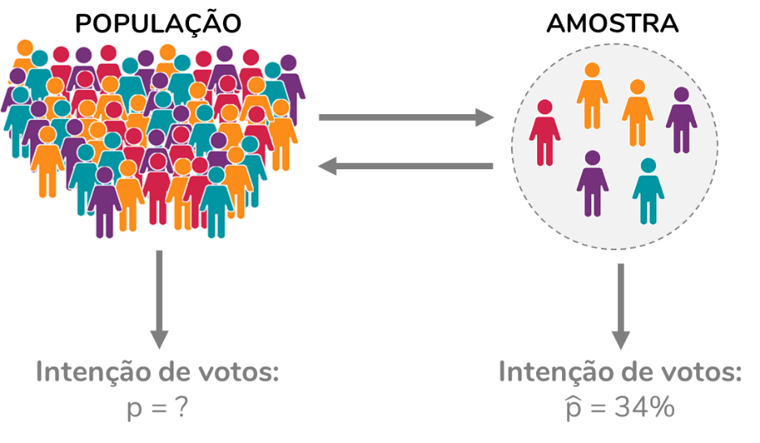
DEFINITION
An interval of confidence is a statistical estimation based on a sample of the population, indicating a range of values where the true population indicator is likely to be contained, commonly expressed with a confidence level, such as 95%.
LITERATURE REVIEW | CONFIDENCE INTERVALS

Slide 12
DEFINITION
An interval of confidence is a statistical estimation based on a sample of the population, indicating a range of values where the true population indicator is likely to be contained, commonly expressed with a confidence level, such as 95%.
SAMPLE
SAMPLING
LITERATURE REVIEW | CONFIDENCE INTERVALS

Slide 13
DEFINITION
An interval of confidence is a statistical estimation based on a sample of the population, indicating a range of values where the true population indicator is likely to be contained, commonly expressed with a confidence level, such as 95%.
SAMPLE
SAMPLING
LITERATURE REVIEW | CONFIDENCE INTERVALS
Population Indicator
Θ
Mean, median,
percentiles/proportion … ?

Slide 14
DEFINITION
An interval of confidence is a statistical estimation based on a sample of the population, indicating a range of values where the true population indicator is likely to be contained, commonly expressed with a confidence level, such as 95%.
SAMPLE
SAMPLING
LITERATURE REVIEW | CONFIDENCE INTERVALS
Population Indicator
Θ
Mean, median,
percentiles/proportion … ?
Confidence level: 95%
UPPER LIMIT
Θ
Statistical Methods
LOWER LIMIT

Slide 15
DEFINITION
An interval of confidence is a statistical estimation based on a sample of the population, indicating a range of values where the true population indicator is likely to be contained, commonly expressed with a confidence level, such as 95%.
SAMPLE
SAMPLING
LITERATURE REVIEW | CONFIDENCE INTERVALS
Population Indicator
Θ
Mean, median,
percentiles/proportion … ?
Confidence level: 95%
UPPER LIMIT
Confidence Interval =
± Margin of Error
Θ
Θ
Statistical Methods
LOWER LIMIT

Slide 16
CALCULATION STEPS
Determine the Confidence Level (CL)
Identify the Standard Deviation (σ) or the Standard Deviation Estimate (s)
Determine the Sample Size (n)
Choose the Appropriate Distribution
Calculate the Margin of Error Estimator
Calculate the Confidence Interval

Slide 17
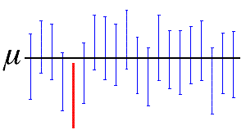
CALCULATION STEPS
Determine the Confidence Level (CL)
Determine the Confidence Level (CL)
The confidence level represents the probability that the confidence interval contains the true population indicator. The usual value for the confidence level is 95%, but it can vary depending on the study's requirements.
LITERATURE REVIEW | CONFIDENCE INTERVALS

Slide 18
CALCULATION STEPS
Determine the Confidence Level (CL)
Identify the Standard Deviation (σ) or the Standard Deviation Estimate (s)
If the population standard deviation (σ) is known, it is used directly in the calculation. Otherwise, if we only have a sample, we use the sample standard deviation (s).
LITERATURE REVIEW | CONFIDENCE INTERVALS

Slide 19
CALCULATION STEPS
Determine the Confidence Level (CL)
Identify the Standard Deviation (σ) or the Standard Deviation Estimate (s)
Determine the Sample Size (n)
The sample size can directly influence the distribution of the data.
LITERATURE REVIEW | CONFIDENCE INTERVALS

Slide 20
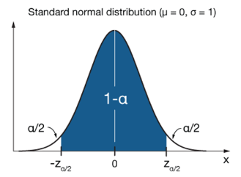
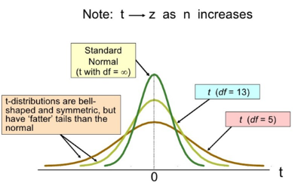
CALCULATION STEPS
Determine the Confidence Level (CL)
Identify the Standard Deviation (σ) or the Standard Deviation Estimate (s)
Determine the Sample Size (n)
Choose the Appropriate Distribution
LITERATURE REVIEW | CONFIDENCE INTERVALS
Large sample: Z-scores
Small sample: T-scores

Slide 21
CALCULATION STEPS
CENTRAL LIMIT THEOREM:
The central limit theorem establishes that, for a sufficiently large sample (typically n > 30), the distribution of the sample mean approaches a normal distribution, regardless of the distribution of the underlying population.
Determine the Confidence Level (CL)
Identify the Standard Deviation (σ) or the Standard Deviation Estimate (s)
Determine the Sample Size (n)
Choose the Appropriate Distribution
LITERATURE REVIEW | CONFIDENCE INTERVALS
Large sample: Z-scores
Small sample: T-scores

Slide 22
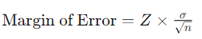
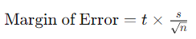
CALCULATION STEPS
Determine the Confidence Level (CL)
Identify the Standard Deviation (σ) or the Standard Deviation Estimate (s)
Determine the Sample Size (n)
Choose the Appropriate Distribution
Calculate the Margin of Error Estimator
LITERATURE REVIEW | CONFIDENCE INTERVALS
Large sample: Z-scores
Small sample: T-scores

Slide 23
CALCULATION STEPS
Determine the Confidence Level (CL)
Identify the Standard Deviation (σ) or the Standard Deviation Estimate (s)
Determine the Sample Size (n)
Choose the Appropriate Distribution
Calculate the Margin of Error Estimator
Calculate the Confidence Interval
Confidence Interval =
Θ
± Margin of Error

Slide 24
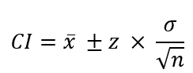
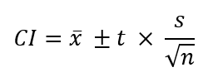
Both assume a normal or approximately normal distribution.
DIRECT APPLICATIONS EXAMPLE
Determine the Confidence Level (CL)
Identify the Standard Deviation (σ) or the Standard Deviation Estimate (s)
Determine the Sample Size (n)
Choose the Appropriate Distribution
Calculate the Margin of Error Estimator
Calculate the Confidence Interval
Confidence Interval for Population Mean:
When Population Variance is Known:
When Population Variance is not Known:
Both assume a normal or approximately normal distribution.

Slide 25
When Population Variance is Known:
NON PARAMETRIC METHODS
Method | Sampling Technique | Assumptions | Advantages | Limitations
Jackknife | Systematically removes one observation from the dataset to create new samples. | Assumes the data is independent and identically distributed | - Simple to implement and understand. - Useful for estimating bias and variance. | - Less effective with skewed or non-normal distributions. - Limited sample size can lead to less reliable estimates.
Bootstrap | Generates multiple resampled datasets by sampling with replacement from the original data. | No specific distributional assumptions; relies on the empirical distribution. | - Very flexible and applicable to a wide range of data types. - Effective for small sample sizes and complex data structures. | - Can be computationally intensive. - May produce unreliable estimates with very small or highly skewed datasets.
Kernel Density Estimation (KDE) | Creates a smooth estimate of the probability density function based on the data. | No assumptions about the underlying distribution; relies purely on the data. | - Excellent for capturing complex features of the data, such as skewness and multimodality. - Provides a continuous estimate of the density function. | - Requires careful selection of bandwidth for accuracy. - Does not inherently generate discrete samples or confidence intervals without additional methods.

Slide 26
METHODOLOGY
STUDY CASES

Slide 27
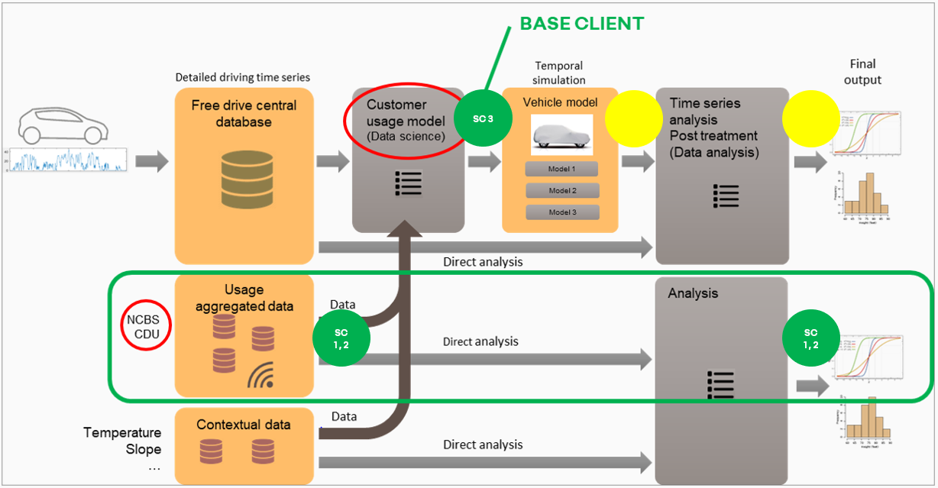
Table: Confidence Interval for the mean on total public
CUSTOMER USAGE WORKFLOW
METHODOLOGY

Slide 28
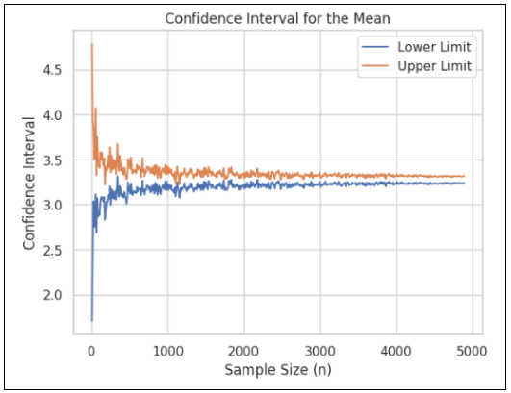
Table: Confidence Interval for the mean on total public
STUDY CASE 1
The first case study was conducted using aggregated CDU data, containing the valid trips of one model vehicles at Renault. The objective was to calculate the confidence interval for the variable "number of trips per vehicle per day," segmented by various countries. Several tests were conducted, including a comparison between confidence interval methods and the observation of the interval based on sample size.
Method | Confidence Interval
Formula | [3.24 – 3.31]
Bootstrap | [3.23 – 3.32]
Jackknife | [3.23 – 3.32]
Table: Confidence Interval for the mean on total public
METHODOLOGY
Figure: Variation of the Confidence Interval with the sample size decrease using Bootstrap

Slide 29
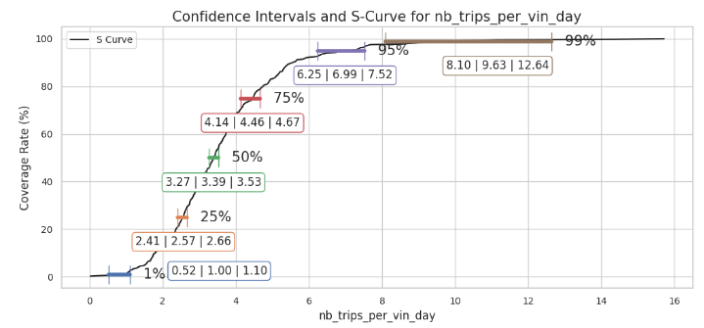
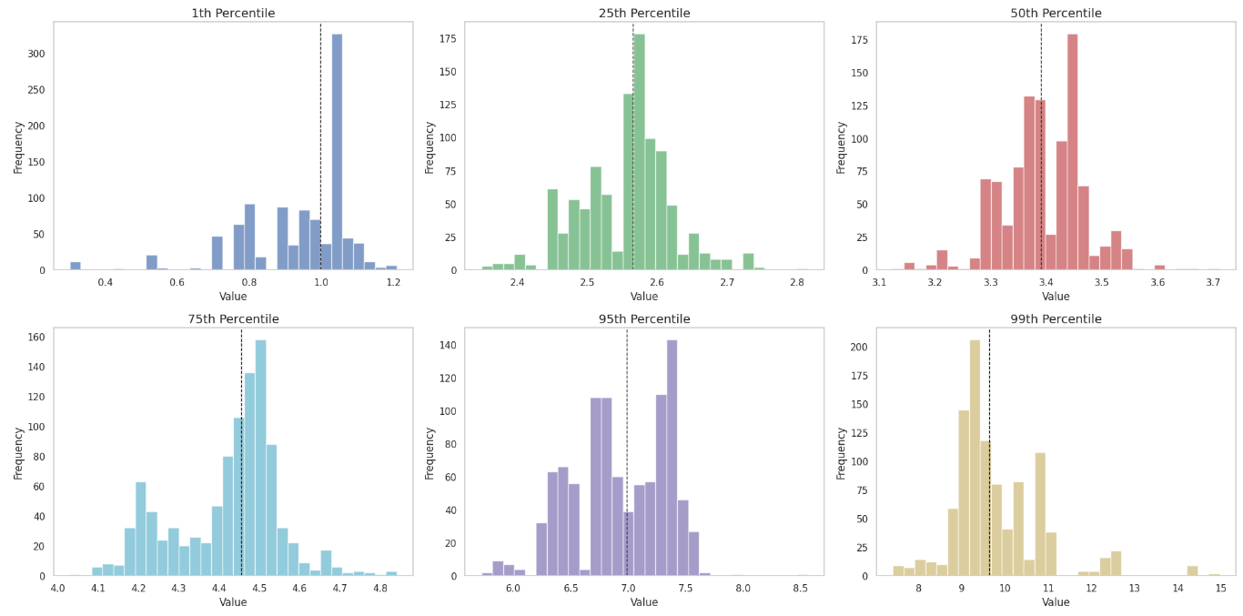
Table: Confidence Interval for the mean on total public
STUDY CASE 1
Figure: Confidence Intervals and S-Curve for “Number of trips per VIN and per day”
S Curve and Percentiles
METHODOLOGY
Figure: Data distribution for the percentiles of the S-Curve

Slide 30
Table: Confidence Interval for the mean on total public
Higher percentiles
Worst Confidence Interval
STUDY CASE 1
Figure: Confidence Intervals and S-Curve for “Number of trips per VIN and per day”
Conclusions:
Bootstrap
Sample Size
Higher percentiles
METHODOLOGY
Figure: Data distribution for the percentiles of the S-Curve

Slide 31
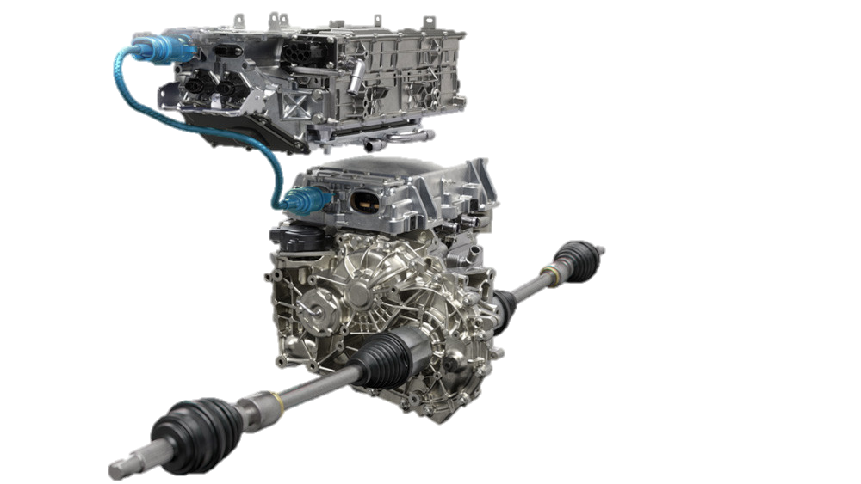
Table: Confidence Interval for the mean on total public
STUDY CASE 2
The second case study focused on analyzing the usage behavior of the automotive differential, specifically targeting customers who impose severe conditions on this component, leading to increased damage.
The variable “ratiodurationRawSpeedRangeBetweenXAndY” was selected for the study. This variable represents the proportion of time the vehicle's speed was within a specified range, between X and Y. It provides insight into how often and for how long the vehicle operates within that speed range, which is crucial for assessing the differential's exposure to potentially damaging conditions.
METHODOLOGY

Slide 32
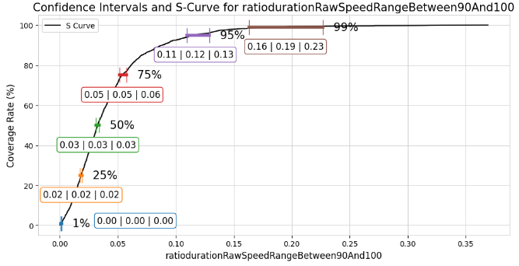
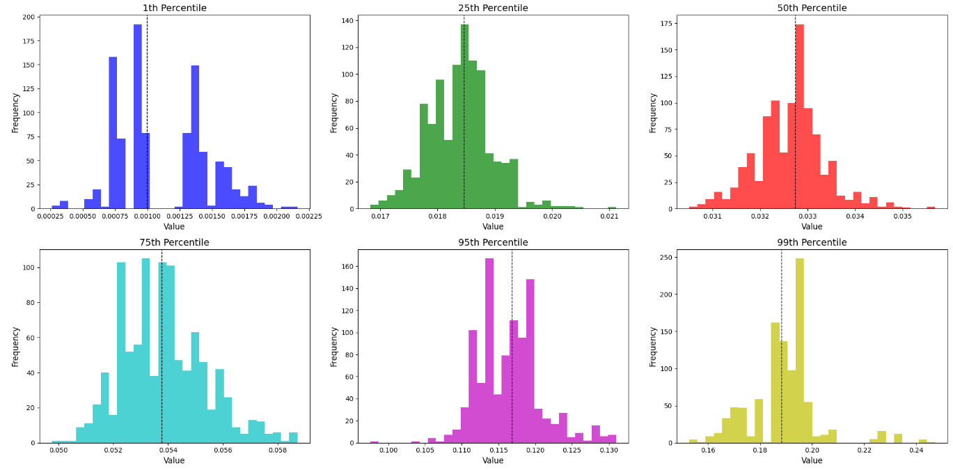
Table: Confidence Interval for the mean on total public
STUDY CASE 2
Figure: Confidence Intervals and S-Curve for “ratiodurationRawSpeedRangeBetween90And100”
S Curve and Percentiles
METHODOLOGY
Figure: Data distribution for the percentiles of the S-Curve

Slide 33
Table: Confidence Interval for the mean on total public
Higher percentiles
Worst Confidence Interval
STUDY CASE 2
Figure: Confidence Intervals and S-Curve for “ratiodurationRawSpeedRangeBetween90And100”
Conclusions:
Bootstrap confirmation method
Higher percentiles
METHODOLOGY
Figure: Data distribution for the percentiles of the S-Curve

Slide 34
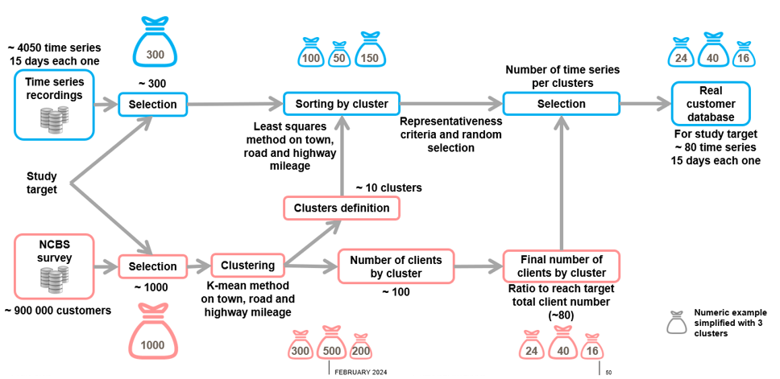
Table: Confidence Interval for the mean on total public
STUDY CASE 3
The third case study will focus on confidence interval calculations utilizing the Real Customer Database. This database, constructed for one vehicule model, from a real-world customer usage model, incorporates time series data from approximately 100 customers. Unlike the aggregated CDU data, which was randomly sampled, the Real Customer Database is generated through specific filtering and clustering.
METHODOLOGY
Figure: Real Customer Database Construction Workflow

Slide 35
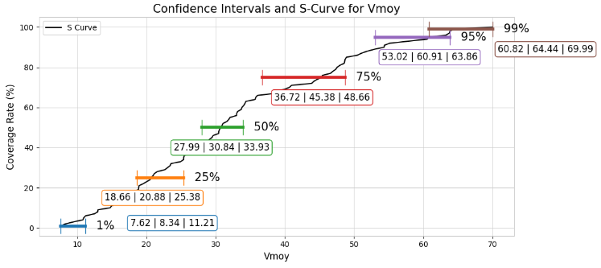
Table: Confidence Interval for the mean on total public
STUDY CASE 3
What happens if we simply apply bootstrap?
METHODOLOGY
Figure: Confidence Intervals and S-Curve for “Vmoy” before the models

Slide 36
Table: Confidence Interval for the mean on total public
STUDY CASE 3
METHODOLOGY
Figure: Real Customer Database Construction Workflow

Slide 37
Table: Confidence Interval for the mean on total public
STUDY CASE 3
BASE CLIENT (100 Clients)
METHODOLOGY
NCBS (Survey)
Figure: Real Customer Database Construction Workflow

Slide 38
Table: Confidence Interval for the mean on total public
STUDY CASE 3
NCBS (Survey)
BASE CLIENT (100 Clients)
METHODOLOGY
How the uncertainty of the NCBS represents the uncertainty on the Base Client ?

Slide 39
Table: Confidence Interval for the mean on total public
STUDY CASE 3
NCBS (Survey)
Base CLIENT
REGRESSION
MODEL
BASE CLIENT (100 Clients)
Step 1
Vmoy = f(V,R,A)
METHODOLOGY
V,R,A and Vmoy
Features | Specification | Type
Vmoy | Mean Speed | Response
V | (Distance traveled in the City / Total Distance)*100 | Explanatory
R | (Distance traveled on Route / Total Distance)*100 | Explanatory
A | (Distance traveled on Highway / Total Distance)*100 | Explanatory
Table: Features for the Regression

Slide 40
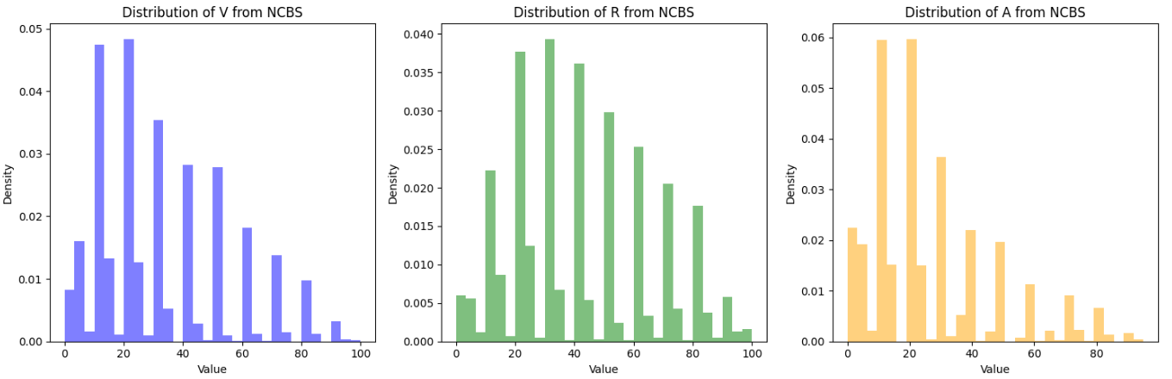
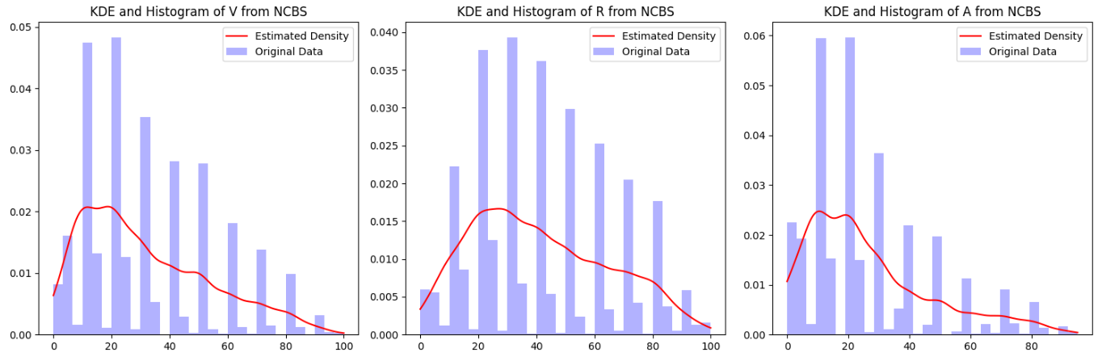
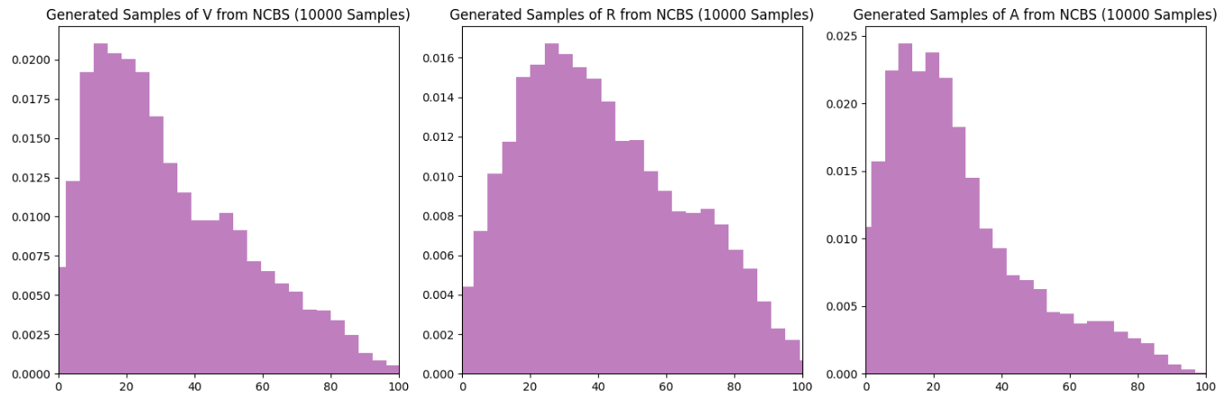
Table: Confidence Interval for the mean on total public
STUDY CASE 3
Step 2
NCBS (Survey)
X = V,R,A
Figure: Data distribution for V,R,A before the model
NON PARAMETRIC MODEL
(KDE)
METHODOLOGY
Figure: Kernel Density estimation for V,R,A
Figure: Generated Samples for V,R,A

Slide 41
Table: Confidence Interval for the mean on total public
STUDY CASE 3
Step 2
NCBS (Survey)
X = V,R,A
NON PARAMETRIC MODEL
(KDE)
Base CLIENT
REGRESSION
MODEL
METHODOLOGY
BASE CLIENT (100 Clients)
Step 1
Vmoy = f(V,R,A)
Vmoy = f(Model NCBS) ± CI
V,R,A and Vmoy

Slide 42
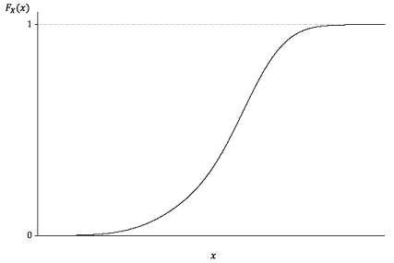
Table: Confidence Interval for the mean on total public
STUDY CASE 3
Step 2
NCBS (Survey)
X = V,R,A
NON PARAMETRIC MODEL
(KDE)
Base CLIENT
REGRESSION
MODEL
METHODOLOGY
BASE CLIENT (100 Clients)
Step 1
Vmoy = f(V,R,A)
Vmoy = f(Model NCBS) ± CI
V,R,A and Vmoy
Step 3

Slide 43
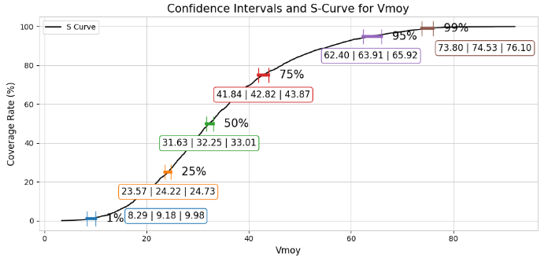
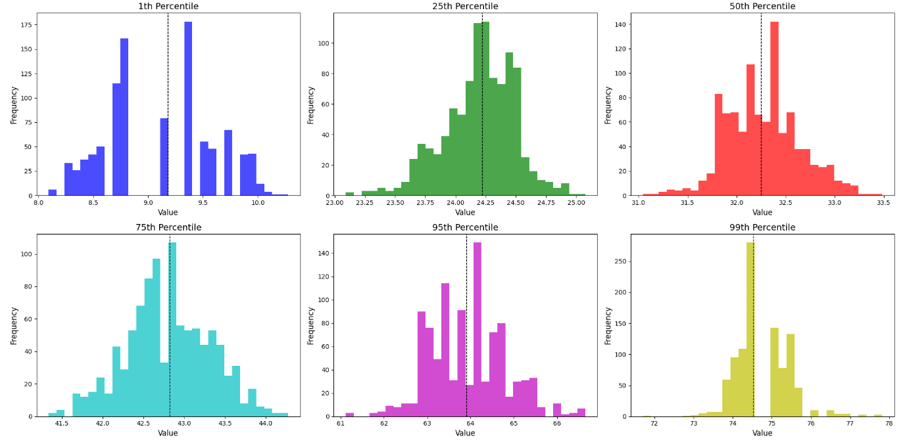
Table: Confidence Interval for the mean on total public
STUDY CASE 3
Figure: Confidence Intervals and S-Curve for “Vmoy” after the models
S Curve and Percentiles
METHODOLOGY
Figure: Data distribution for the percentiles of the S-Curve

Slide 44
Table: Confidence Interval for the mean on total public
Higher percentiles
Worst Confidence Interval
STUDY CASE 3
Figure: Confidence Intervals and S-Curve for “Vmoy” after the models
Conclusions:
Methodology Validated
Higher percentiles
More data is important
METHODOLOGY
Figure: Data distribution for the percentiles of the S-Curve

Slide 45
DELIVERABLES

Slide 46

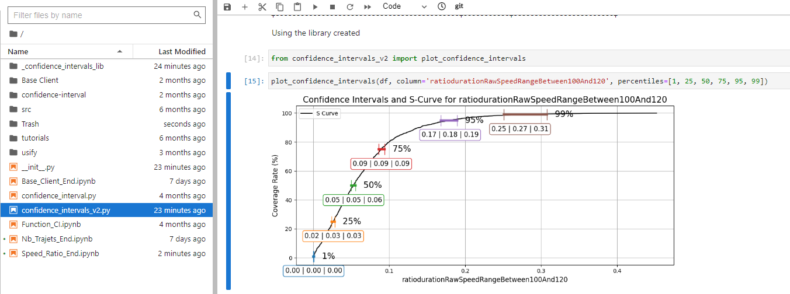
Table: Confidence Interval for the mean on total public
PYTHON LIBRARY DEVELOPED
Bootstrap
Cumulative
distribution
function (CDF)
S CURVE
+
Python Library/ Function
METHODOLOGY
Figure: Example of Confidence Interval Function

Slide 47
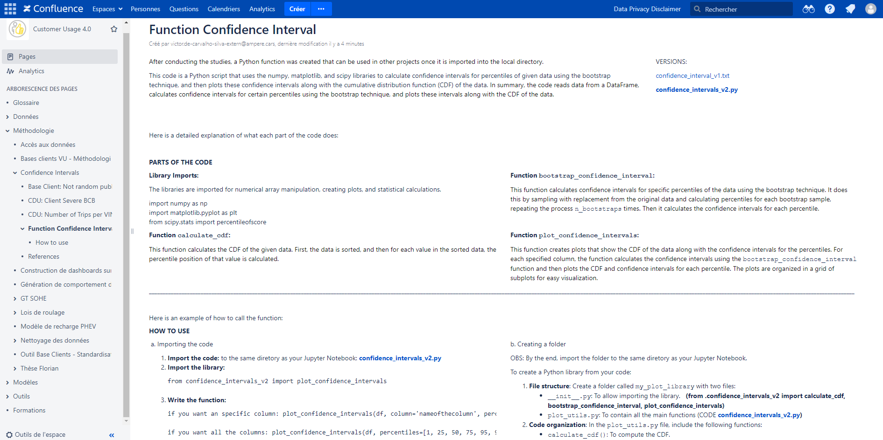
Table: Confidence Interval for the mean on total public
METHODOLOGY DOCUMENTED
Rapport de Stage
Confluence
SharePoint
METHODOLOGY
Figure: Documentation of Python Function - Example

Slide 48
CONCLUSIONS

Slide 49
Table: Confidence Interval for the mean on total public
MAIN CONCLUSIONS
- Methods: The use of the bootstrap method proved to be more effective and flexible for handling non-normal distributions and estimating variability in extreme percentiles, critical for simulating intense usage scenarios.
- Impact of Sample Size: Larger samples result in narrower confidence intervals, reducing uncertainty.
- At higher percentiles (95th and 99th), the intervals were wider, reflecting greater variability.
- Percentile Selection: Careful selection of percentiles is essential, as higher percentiles can distort the perception of typical user behavior, impacting strategic decisions.
- Integration into Workflow: Incorporating confidence interval calculations into the data analysis process improves the accuracy of simulations and real-world scenario modeling.
CONCLUSIONS

Slide 50
Table: Confidence Interval for the mean on total public
FUTURE APPLICATIONS
Confidence Interval Calculations
Integration of confidence intervals into the workflow.
Improves quantification of uncertainty in customer usage data.
Enhances accuracy in simulations and optimizations for vehicle systems.
Real-Time Data Integration
Incorporating real-time feedback from connected vehicles.
Dynamic adjustments in product design and preventive maintenance.
Enhancements to Base Client Model
Utilize advanced machine learning and regression model evaluations.
Expand cross-validation methods for improved accuracy and generalization.
Expansion to New Segments
Broaden analysis to include data from new vehicle models and segments.
Provides deeper insights and wider application of methodologies.
CONCLUSIONS

Slide 51
Table: Confidence Interval for the mean on total public
CONTRIBUTIONS TO STUDENT GROWTH
Professional Experience:
Exposure to a large corporate environment.
Enhanced skills in analyzing real-world data and complex systems.
Soft Skills Development:
- Improved communication, teamwork, and adaptability
.Language skills: Advanced proficiency in English and French.
Application of DANI Program Knowledge:
Strong foundation in statistical analysis, machine learning, and data visualization.
Practical application of theoretical concepts from the DANI program.
Global Perspective:
Exposure to international work culture and global industry trends.
Broader understanding of worldwide data science challenges.
Future Impact:
Well-rounded preparation for future data science projects.
Grateful for the opportunity to learn from talented colleagues.
CONCLUSIONS

Slide 52
Table: Confidence Interval for the mean on total public
BIBLIOGRAPHY
[1] Bishop, C. M. (2006). Pattern Recognition and Machine Learning. Springer.
[2] Blitzstein, J. K., & Hwang, J. (2014). Introduction to Probability. CRC Press.
[3] Conover, W. J. (1999). Practical Nonparametric Statistics (3rd ed.). Wiley.
[4] Devore, J. L. (2011). Probability and Statistics for Engineering and the Sciences (8th ed.). Cengage Learning.
[5] Efron, B. (1979). Bootstrap methods: Another look at the jackknife. Annals of Statistics, 7(1), 1-26.
[6] Freedman, D., & Pisani, R. (2007). Statistics. Norton & Company.
[7] Gelman, A., Carlin, J. B., Stern, H. S., Dunson, D. B., Vehtari, A., & Rubin, D. B. (2013). Bayesian Data Analysis (3rd ed.). CRC Press.
[8] Hastie, T., Tibshirani, R., & Friedman, J. (2009). The Elements of Statistical Learning: Data Mining, Inference, and Prediction (2nd ed.). Springer.
[9] James, G., Witten, D., Hastie, T., & Tibshirani, R. (2013). An Introduction to Statistical Learning with Applications in R. Springer.
[10] Montgomery, D. C., & Runger, G. C. (2014). Applied Statistics and Probability for Engineers (6th ed.). Wiley.
[11] Navidi, W. (2015). Statistics for Engineers and Scientists (4th ed.). McGraw-Hill.
[12] Renault Annual Report 2023. Available in the financial reports section of the Renault Group website.
[13] Renault Group Official Website. https://www.renaultgroup.com
[14] Triola, M. F. (2017). Elementary Statistics (13th ed.). Pearson.
[15] Wasserman, L. (2004). All of Statistics: A Concise Course in Statistical Inference. Springer.
BIBLIOGRAPHY

Slide 53
Thank you !

